Slide 1
The Wonderful World of Food
A Tasty Journey

Slide 2
Understanding Food
- Definition: Food is any substance consumed to provide nutritional support for the body.
- Essential Nutrients: Macronutrients (carbohydrates, proteins, fats) and micronutrients (vitamins, minerals) are essential for our health.
- Fuel for the Body: Food provides energy, aiding growth and maintaining bodily functions.

Slide 3
The History of Food
- Ancient Civilizations: Early humans foraged and hunted, with cooking techniques evolving over time.
- Agricultural Revolution: The domestication of plants and animals led to a shift towards settled communities and new food sources.
- Trade and Exploration: Spices, new ingredients, and culinary techniques were exchanged, shaping global cuisine.

Slide 4
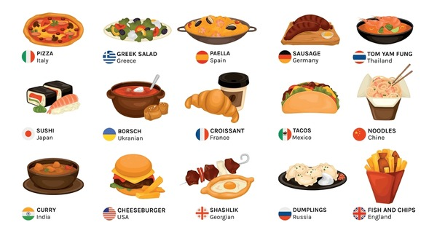
A Colorful Feast
The Vibrant World of Food Presentation

Slide 5
Cultural Significance of Food
- Social Bonding: Sharing meals brings people together and strengthens social connections.
- Traditions and Rituals: Food plays a central role in religious ceremonies, festivals, and cultural celebrations.
- Expression of Identity: Cuisine is often a source of national pride and a way to preserve cultural heritage.

Slide 6
Food and Health
- Balanced Diet: Eating a variety of foods ensures we get the nutrients needed for optimal health.
- Preventative Medicine: A healthy diet can lower the risk of chronic diseases and boost our immune system.
- Mental Health: Research suggests a link between a healthy diet and improved mood, memory, and overall mental wellbeing.

Slide 7
The Future of Food
- Sustainable Food Systems: Innovations in agriculture aim to reduce environmental impact and ensure food security.
- Alternative Proteins: Plant-based meats, insect proteins, and lab-grown meats are gaining popularity for ethical and environmental reasons.
- Personalized Nutrition: Tailored diets and supplements based on individual genetic profiles may become commonplace.

Slide 8
Summary
- Food is a fascinating and multifaceted topic, integral to human life and culture.
- It has a rich history and plays a vital role in our health, happiness, and social connections.
- Looking ahead, innovations in agriculture and food technology will shape how we eat and impact our planet.

Slide 9
Next Steps
- Explore local cuisines: Embrace diverse culinary experiences and learn about their cultural significance.
- Support sustainable food practices: Promote environmentally conscious food choices and reduce food waste.
- Educate on nutrition: Spread awareness about the link between diet and health to empower healthier food choices.

Slide 10
Bon Appétit!

Slide 11
Summary
This presentation provided an overview of 'food', highlighting the most important points and insights.

Slide 12
Next Steps
1. Review and customize the slides.
2. Add supporting data or visuals.
3. Rehearse your delivery.

Slide 13
Thank You!

